Slide 1
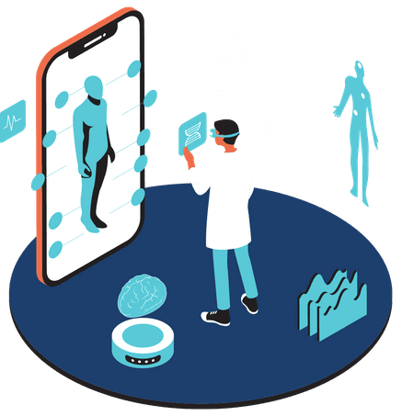

Predictive Analytics in Healthcare: Thyroid Detection Using Machine Learning
Name: Pallabi Kar
Redg No: 230720100094

Slide 2
Overview
Thyroid Disorders:
Affect millions globally, leading to conditions like hypothyroidism and hyperthyroidism.
Early detection is crucial for effective treatment and management.
Role of Machine Learning:
Machine Learning (ML) offers potential in predictive diagnostics by analyzing complex medical data.
ML models can enhance the accuracy and speed of thyroid disorder detection.
Problem Addressed
Diagnostic Challenges:
Symptoms of thyroid disorders often overlap with other conditions, making diagnosis difficult.
Traditional diagnostic methods can be time-consuming and require expert interpretation.
Need for Predictive Models:
There is a growing need for automated systems that can assist healthcare professionals in diagnosing thyroid disorders

Slide 3
Predictive Analytics Techniques Used
Support Vector Machines (SVM):
Used for classification tasks; effective in separating patients with and without thyroid disorders.
Decision Trees:
Provide a visual representation of decision-making processes, useful in understanding the logic behind diagnoses.
Neural Networks:
Particularly effective in recognizing patterns in large and complex datasets.
Can handle non-linear relationships in medical data.

Slide 4
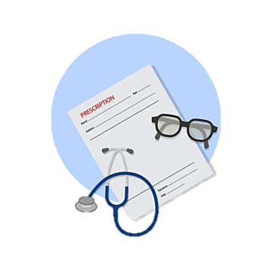
Data Involved
Patient Medical History:
Includes details of past illnesses, family history of thyroid disorders, and previous treatments.
Lab Results:
Crucial parameters include TSH (Thyroid Stimulating Hormone), T3 (Triiodothyronine), and T4 (Thyroxine) levels.
These biochemical markers are essential for diagnosing thyroid conditions.
Demographic Data:
Age, gender, geographic location, and lifestyle factors that may influence the likelihood of thyroid disorders.

Slide 5
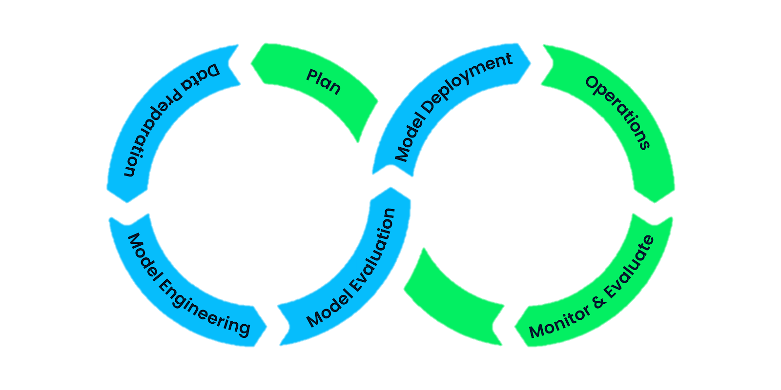
Methodology
Data Collection:
Gathered from hospitals, healthcare databases, and clinical records.
Includes both structured (numerical data) and unstructured (textual data) formats.
Data Preprocessing:
Handling missing values through imputation techniques.
Normalizing lab results to ensure consistency across the dataset.
Feature selection to identify the most relevant predictors.
Model Development and Training:
Splitting data into training and testing sets.
Applying cross-validation to avoid overfitting.
Training models using historical patient data.
Model Evaluation:
Assessing model performance using metrics like accuracy, precision, recall, and F1-score.
Comparing different models to identify the best-performing one.

Slide 6
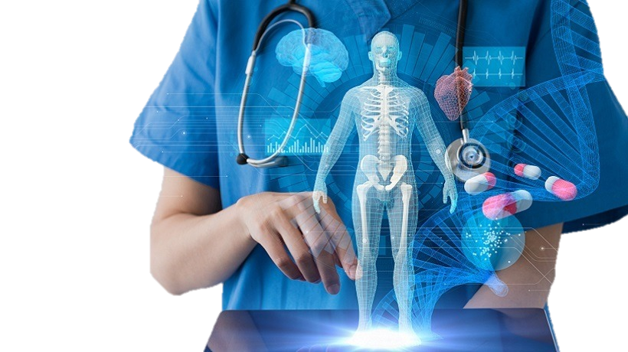
Outcome and Impact
Outcomes Achieved:
Early Detection: Machine learning models enable earlier diagnosis of thyroid disorders, leading to timely intervention.
Improved Accuracy: ML models have demonstrated higher accuracy compared to traditional diagnostic methods.
Efficiency Gains: Automation reduces the time needed for diagnosis, allowing healthcare professionals to focus on patient care.
Impact on Healthcare:
Patient Outcomes: Early detection improves treatment outcomes, reducing complications and mortality.
Healthcare Costs: Reducing unnecessary tests and treatments through accurate diagnosis lowers overall healthcare costs.
Adoption of ML in Medicine: Successful implementation in thyroid detection encourages broader adoption of ML in other areas of healthcare.

Slide 7
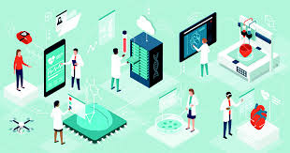
Key Learnings
Importance of Data Quality:
High-quality, well-labeled data is crucial for training effective ML models.
Continuous Model Improvement:
Regular updates and retraining of models are necessary to maintain accuracy and relevance as new data becomes available.
Balancing Accuracy with Interpretability:
In healthcare, models must be interpretable by clinicians to gain trust and ensure correct decision-making.
Ethical Considerations:
Ensuring patient data privacy and addressing biases in model predictions are critical for ethical AI in healthcare.

Slide 8
Conclusion
Summary:
The integration of machine learning in thyroid detection represents a significant advancement in healthcare diagnostics.
Predictive analytics offers the potential to revolutionize how thyroid disorders are diagnosed and treated.
Future Directions:
Continued research and development in ML techniques can further enhance diagnostic accuracy and broaden applications to other medical conditions.
Closing Remark:
Leveraging the power of data and machine learning, healthcare can move towards more personalized, efficient, and effective patient care.

Slide 9


